Slide 1

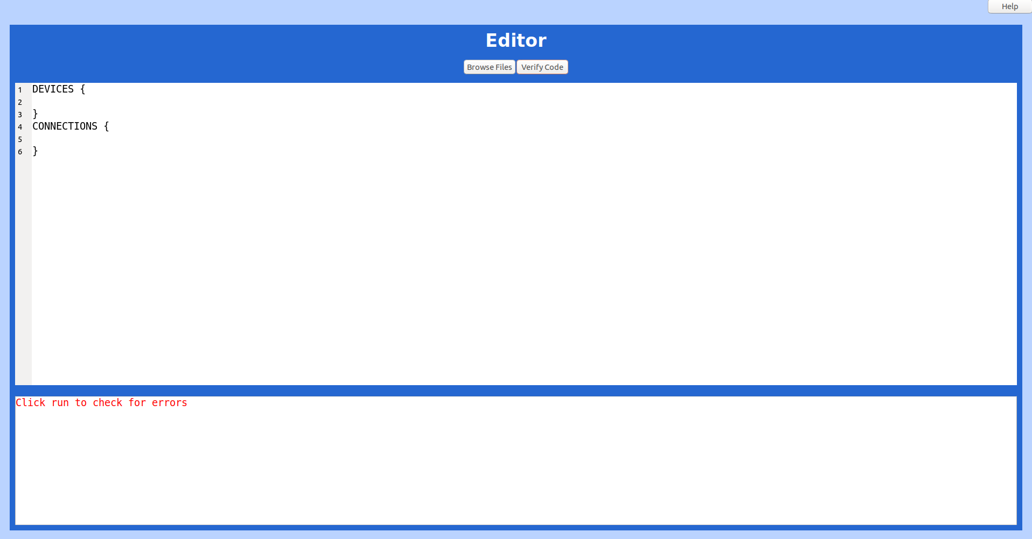
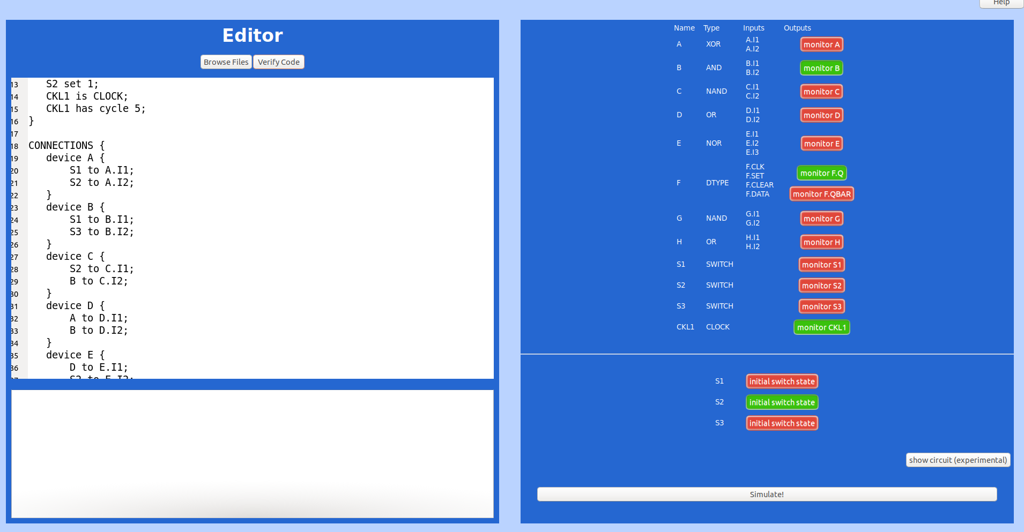
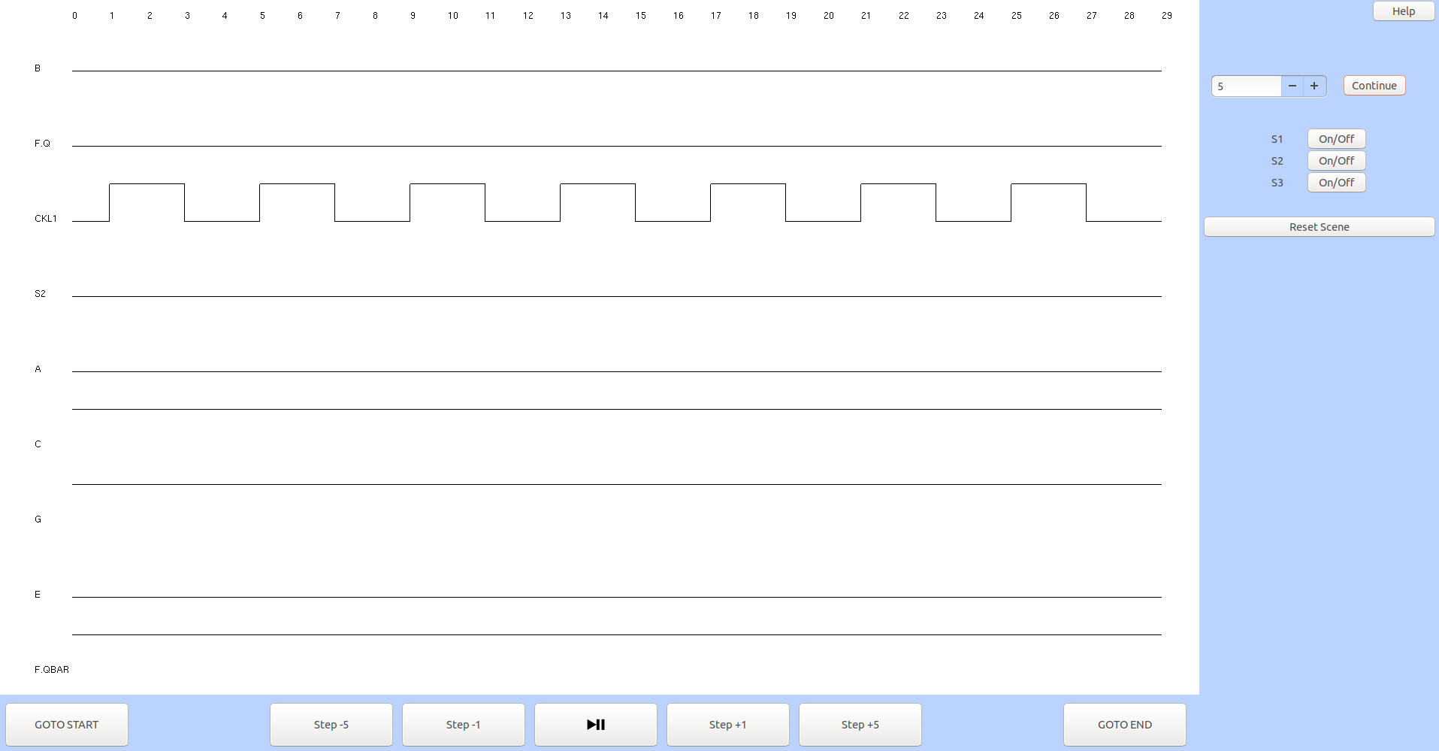
USER GUIDE
STEP 1: getting started
Navigate to the ‘main_project’ directory using the command line
Type ‘export PATH=/usr/local/apps/anaconda3-5.0.1/bin:$PATH’
type ‘python3 main.py’ + press ENTER
STEP 2: define your circuit
Once you are happy with your text, click here.
Type in the circuit definition as per the provided grammar.
Click here to browse your directory to load a text file in which you have defined the circuit.
This will override any inputed text.
Error messages will appear here once you have verified your code.
STEP 3: define your circuit
You can always click help if you are unsure what to do
Once the text is error free, this plane will appear where you can manually select your initial conditions and which signals you are interested in monitoring. Remember that Green means ON!
Click here to see the logic circuit that you are modelling (slightly experimental)
When you are ready, click here to see the signal trace!
Choose a time scale and click continue if you want to run your simulation for longer
STEP 4: run your simulation
Clear your screen by clicking here
You can see the trace of the signals you have chosen to monitor. Plan by clicking and scrolling on the monitor’s window
Change the switch values here
Interact with the simulation using this panel. (Note, some buttons are still under development at this stage)

Slide 2
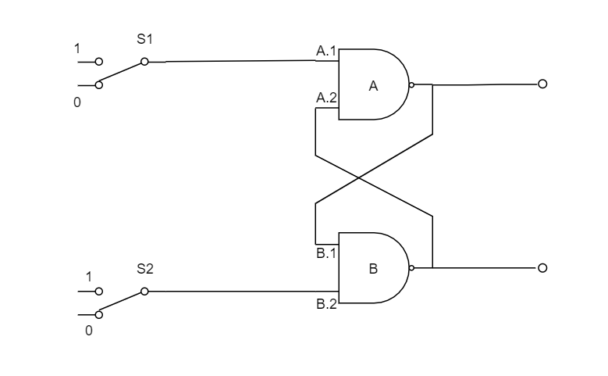
Example text definition 1: simple
DEVICES { A, B are NAND gates; S1, S2 are SWITCH; A, B have 2 inputs; } CONNECTIONS { device A { S1 to A.I1; B to A.I2; } device B { A to B.I1; S2 to B.I2; } } MONITOR { A, B; }

Slide 3
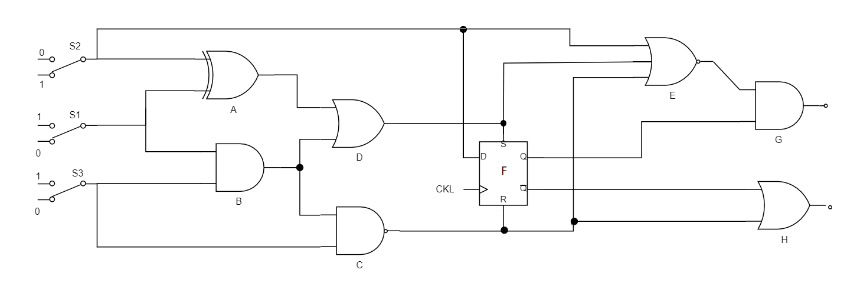
Example text definition 2: complex
DEVICES {
A is XOR;
B is AND;
C is NAND;
D is OR;
E is NOR;
F is DTYPE;
G is NAND;
H is OR;
A,B,C,D,G,H have 2 inputs;
E has 3 inputs;
S1 => S3 are SWITCH;
S2 set 1;
CKL1 is CLOCK;
CKL1 has cycle 5;
}
CONNECTIONS {
device A {
S1 to A.I1;
S2 to A.I2;
}
device B {
S1 to B.I1;
S3 to B.I2;
}
device C {
S2 to C.I1;
B to C.I2;
}
device D {
A to D.I1;
B to D.I2;
}
device E {
D to E.I1;
S2 to E.I2;
C to E.I3;
}
device F {
CKL1 to F.CLK;
D to F.SET;
C to F.CLEAR;
S2 to F.DATA;
}
device G {
E to G.I1;
F.Q to G.I2;
}
device H {
C to H.I1;
F.QBAR to H.I2;
}
}
MONITOR {
B, F.Q, CKL1;
}

Slide 4
Example text definition 3: 3bit ripple counter

